Slide 1

Product introduction
Venus Handicrafts company

Slide 2
Agenda
Synopsis
Problem Statement
Requirements
Implementation environment
Analysis of User Stories
View
Give feedback and ratings
Add items to the cart
SCREEN SHOT
Home Page
About
Gallery
Our Products
Products Detail
Contacts Us
Summary

Slide 3
Synopsis
Problem Statement
Requirements
Implementation environment

Slide 4

Problem Statement
Venus Handicrafts is certified company engaged in manufacturing and exporting of Decorative Handicrafts to global importers, wholesalers and retailers since 1972.
The ever-increasing acceptance of our products on global platform highlights our market presence and goodwill. The company has maintained its market value throughout the world. To enhance its value the organization wants to change the look and feel of the website for which they have approached you.

Slide 5

Problem Statement
The objective is to create a website for them with the below-mentioned requirement specifications.
The website is to be developed for the Windows Platform using HTML5, JavaScript, and Geolocation. The site should work well in all leading browsers including Chrome, IE, Firefox etc.

Slide 6
Requirements
The Home Page with proper sections, graphics and with a suitable logo
Link on the home page must be included such as Home, About us, Gallery, Contact information, Handicrafts products
The look and feel of the project must be made user friendly and uniformity in the color combination must be maintained
Contacts us
No. 8 Ton That Thuyet, Cau Giay, Hanoi
Phone: 0912880315
Email: hocnd.hni@vnpt.vn

Slide 7
Requirements
Handicrafts such as
Iron Handicrafts
Glass Handicrafts
Brass Handicrafts
Wood Handicrafts
Handicraft Decorative
Home Décor
Aluminium Handicrafts
Tables wares
Candle Accessories
And other additional products
Contacts us
Phone: 0912880315
Email: hocnd.hni@vnpt.vn
No. 8 Ton That Thuyet, Cau Giay, Hanoi

Slide 8
Requirements
Navigation of the project must be made smooth
Site Map
Gallery
FAQs
Contacts us
No. 8 Ton That Thuyet, Cau Giay, Hanoi
Phone: 0912880315
Email: hocnd.hni@vnpt.vn

Slide 9

Implementation environment
Notepad/HTML editor
Dreamweaver
IE 5.0/ Netscape 6.0/ Google Chrome 98.0.4758.101/ Safari 15.2

Slide 10
Analysis of User Stories
View
Give feedback and ratings
Add items to the cart

Slide 11
View
Products
When I click on a product, a detailed description of the products will display, including images, price, discount, brief introduction, specification table with a link to document containing a detailed description and manual, ratings, and color variants.
Brands
When I click on the email address, my email address will automatically invoke sending mail to that address. On the general information page, a link navigating to the brand’s products should be present..

Slide 12
Give feedback and ratings
The website shall include a comment section where I can post my comments on certain products

Slide 13
Add items to the cart
The items should also be able to be added to the shopping cart. The number of items in the cart will get updated and displayed on the page whenever I click on the cart button
On the shopping cart page, I will see the list of the products that are currently in the cart. I will be able to remove the items from the cart and modify the quantity of the items either by inserting a number in the input box or clicking the increment/decrement buttons
The price of items and the total bill’s worth will be modified accordingly. our website, displaying details such as customer's name

Slide 14
SCREEN SHOT
Home Page
About
Gallery
Our Products
Products Detail
Contacts Us

Slide 15
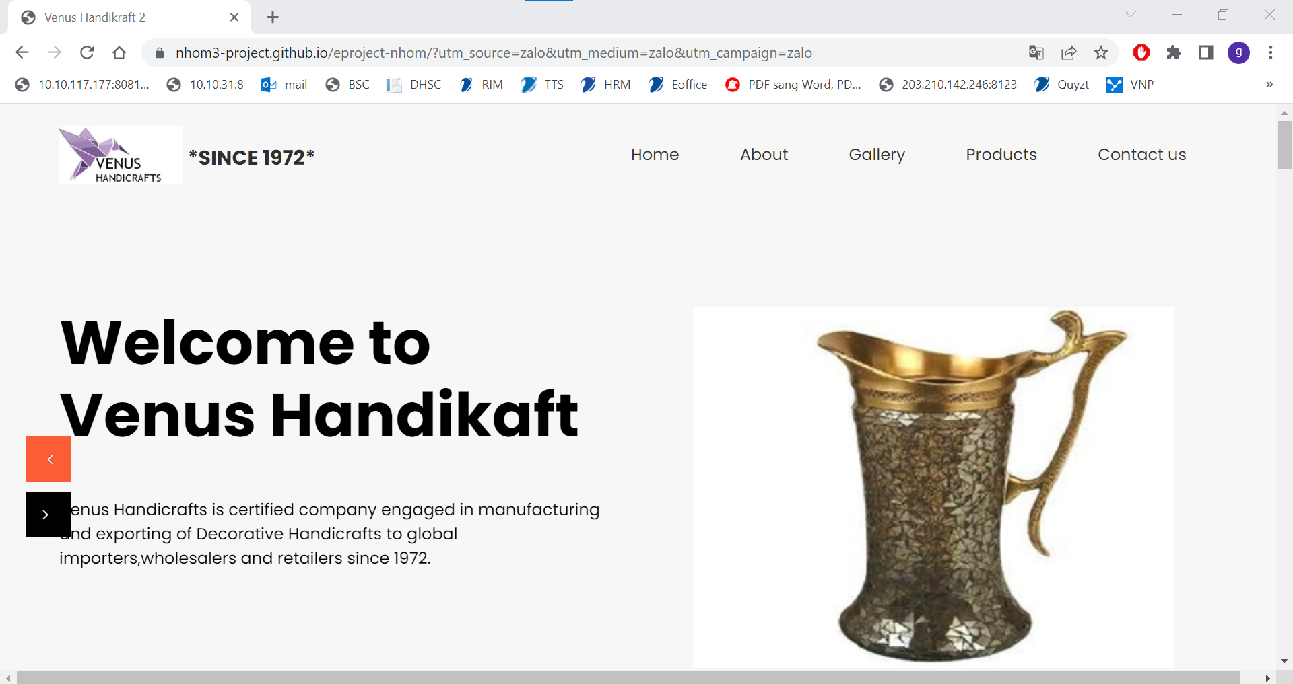
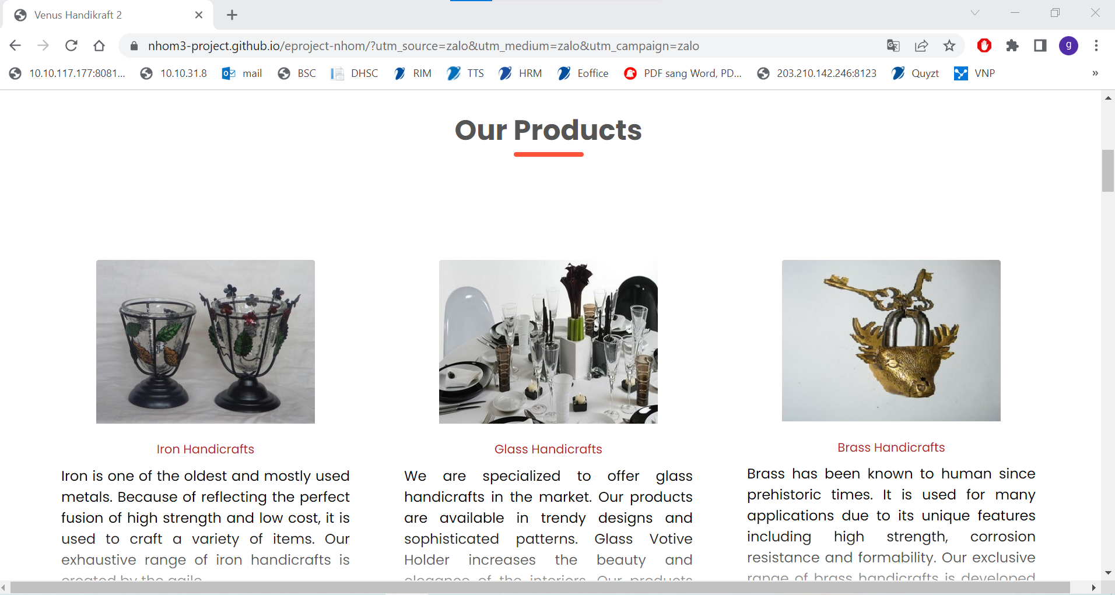
Home Page
https://nhom3-project.github.io/eproject-nhom/

Slide 16
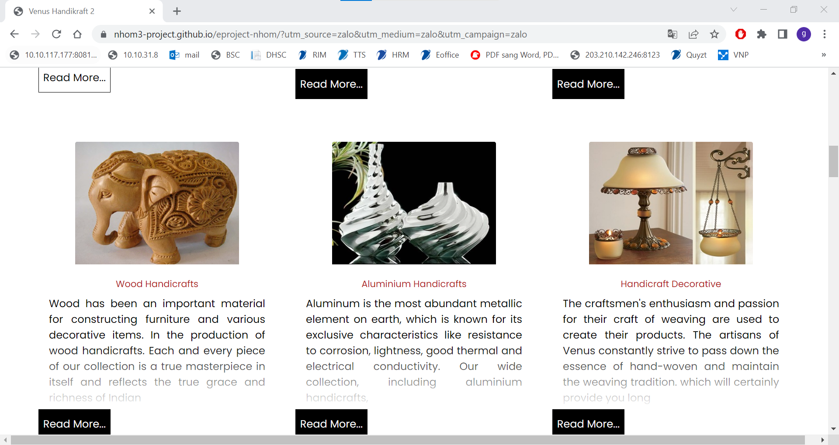
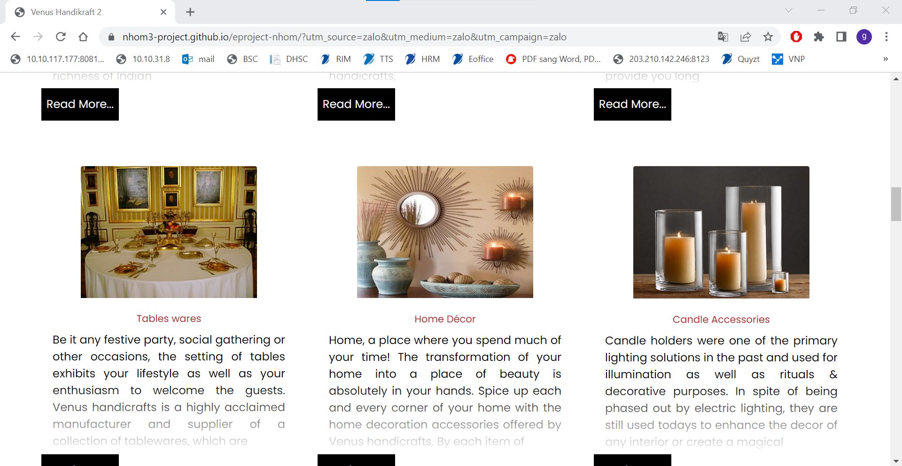
Home Page
https://nhom3-project.github.io/eproject-nhom/

Slide 17
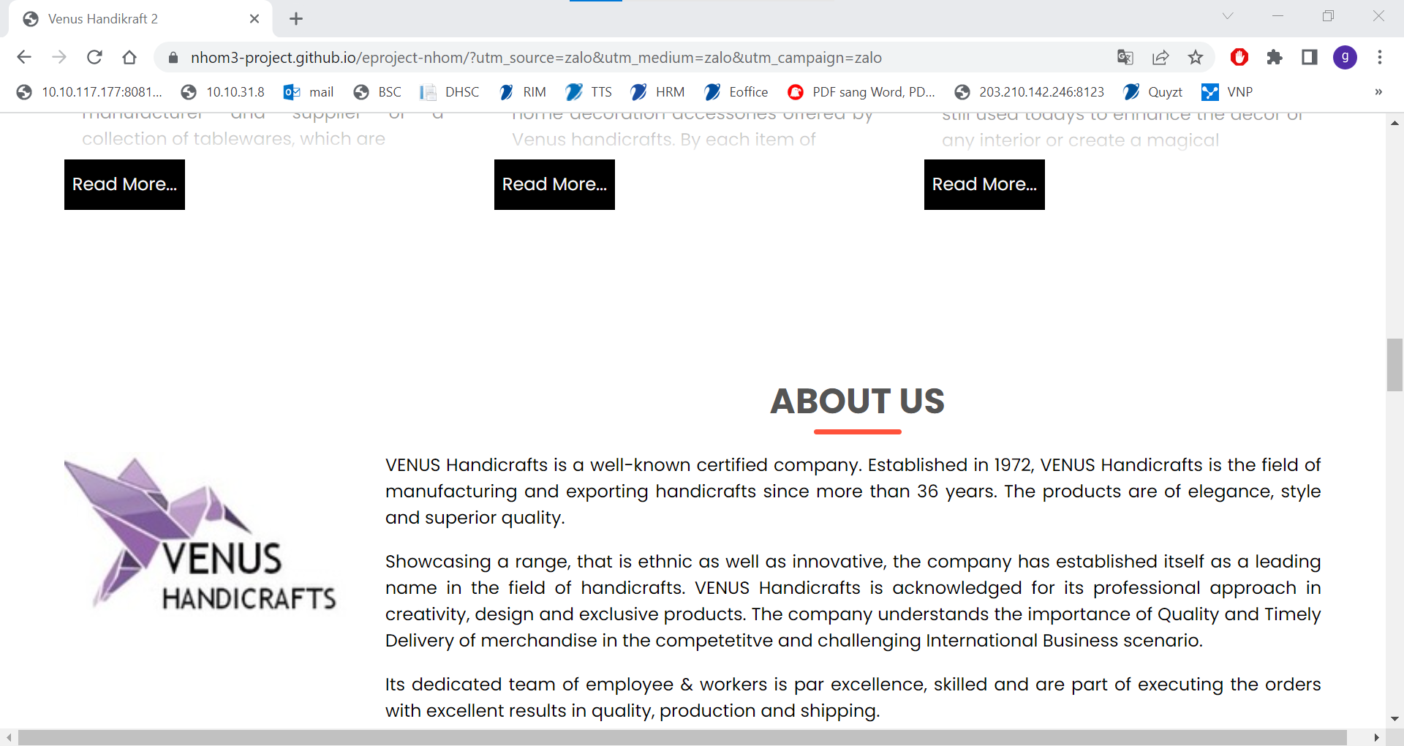
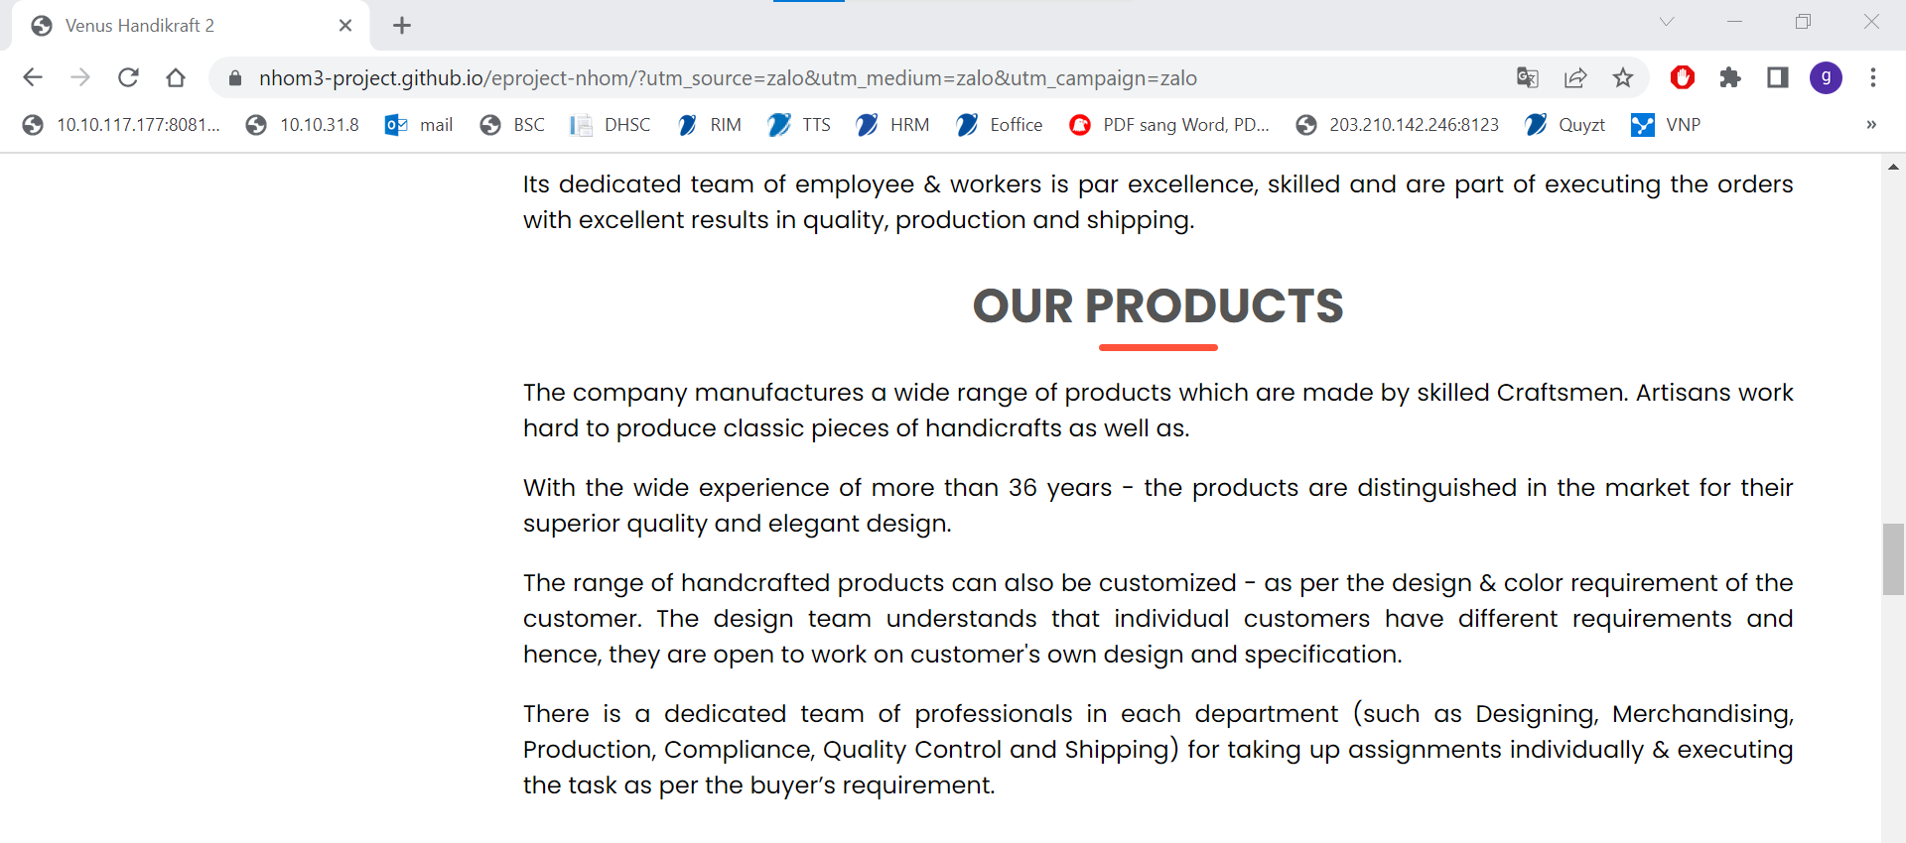
Home Page
https://nhom3-project.github.io/eproject-nhom/

Slide 18
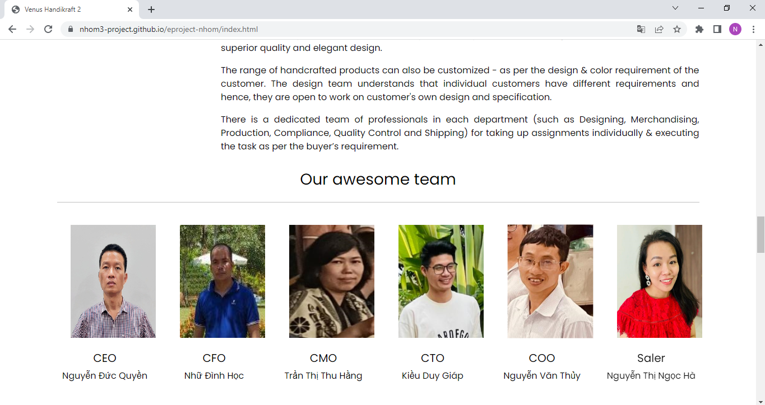
Home Page
https://nhom3-project.github.io/eproject-nhom/

Slide 19
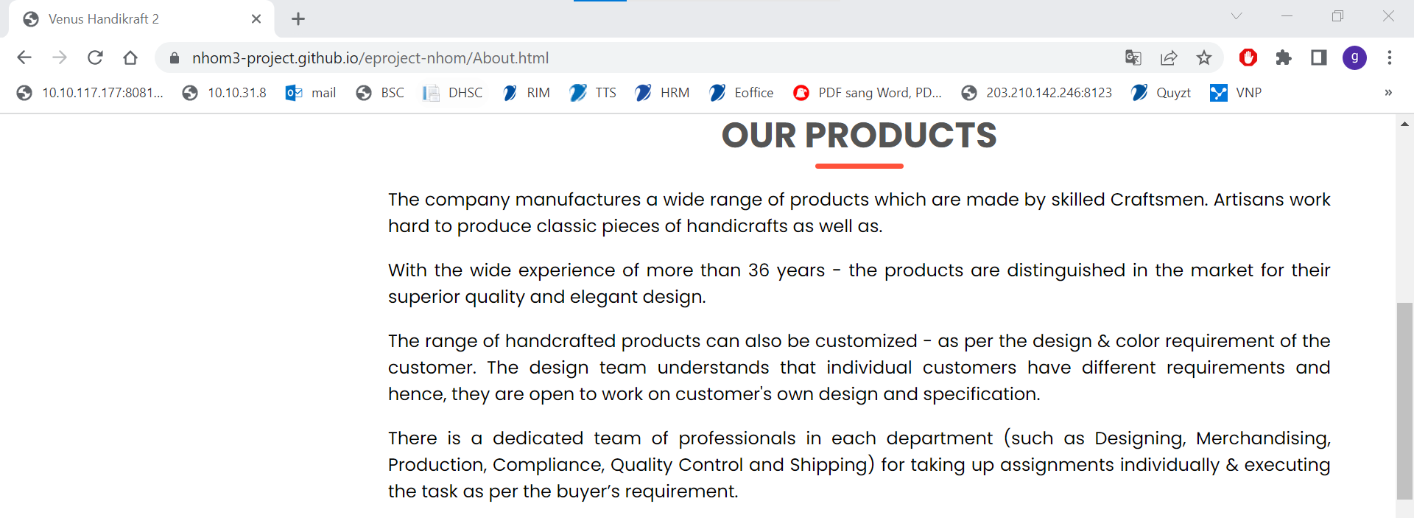
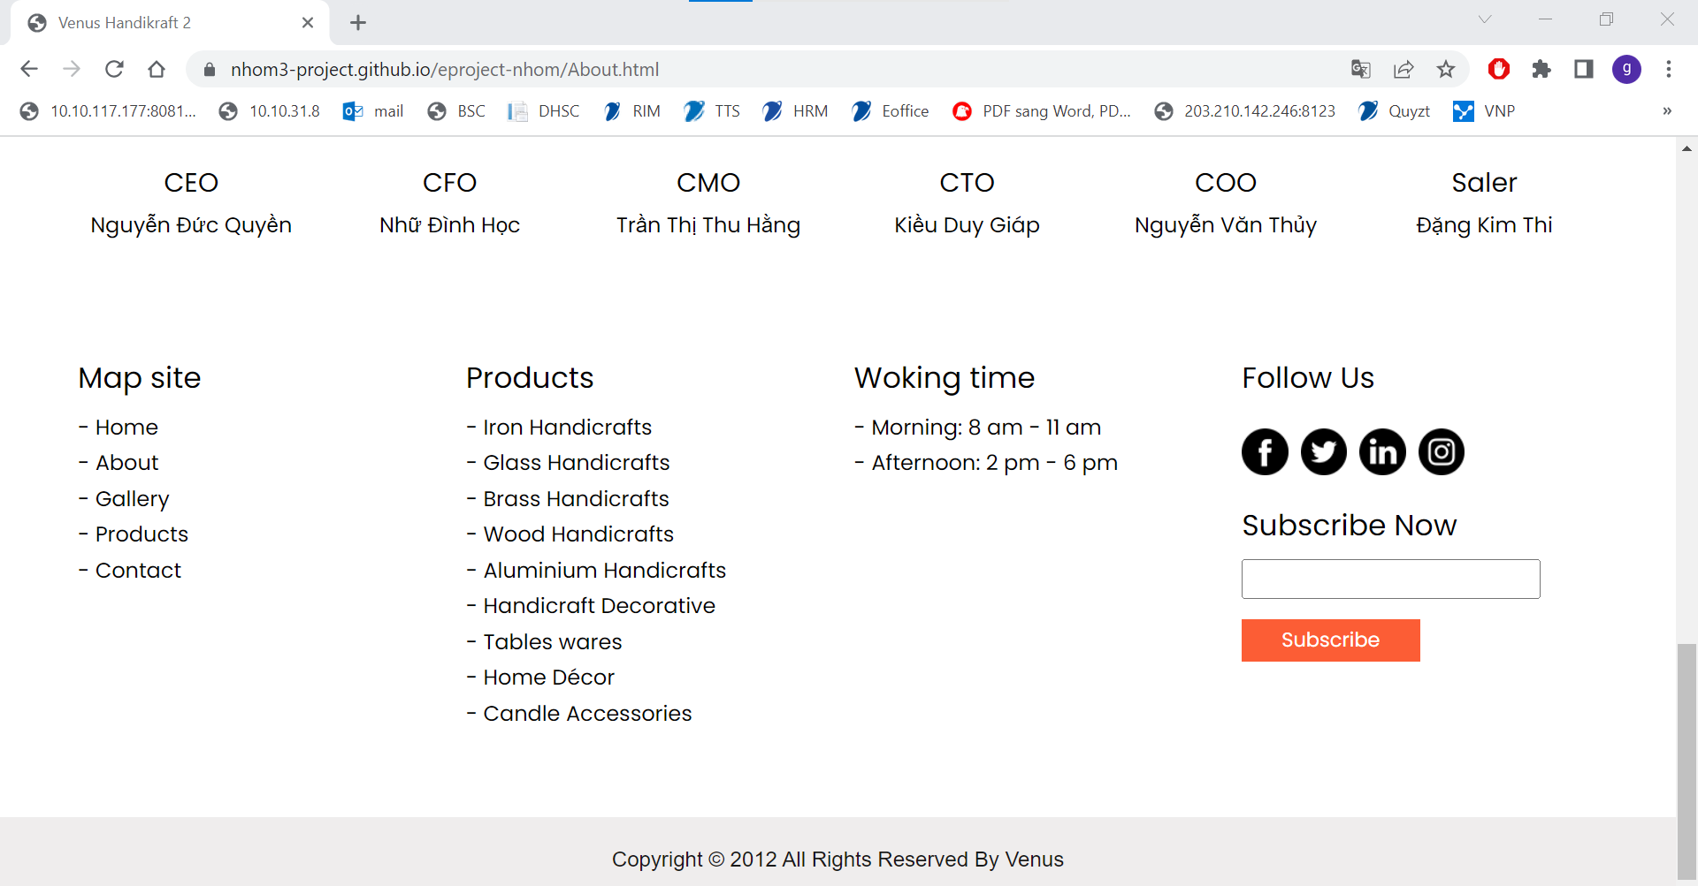
About

Slide 20
About

Slide 21
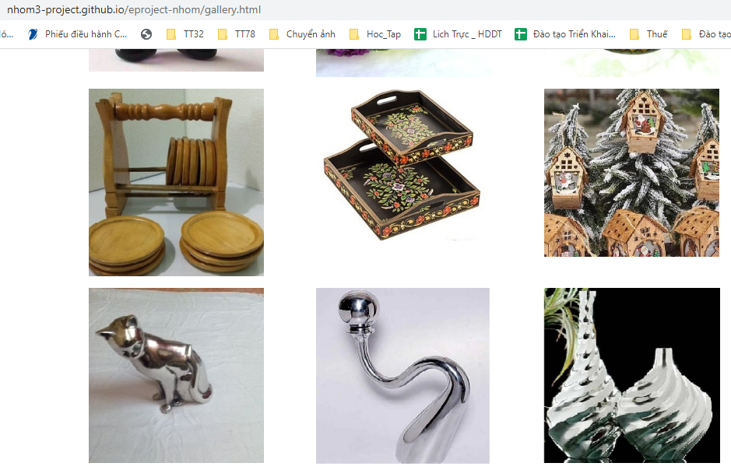
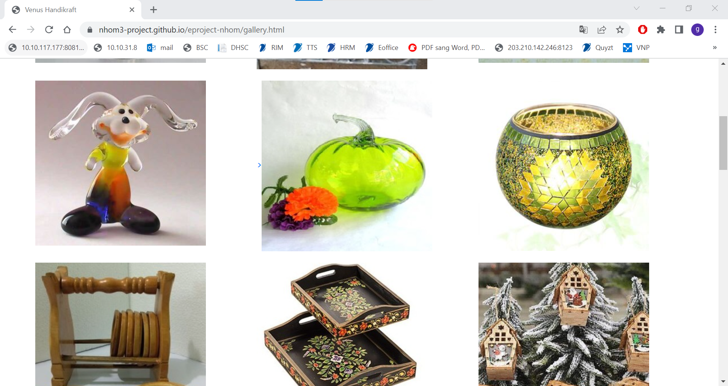
GALLERY

Slide 22
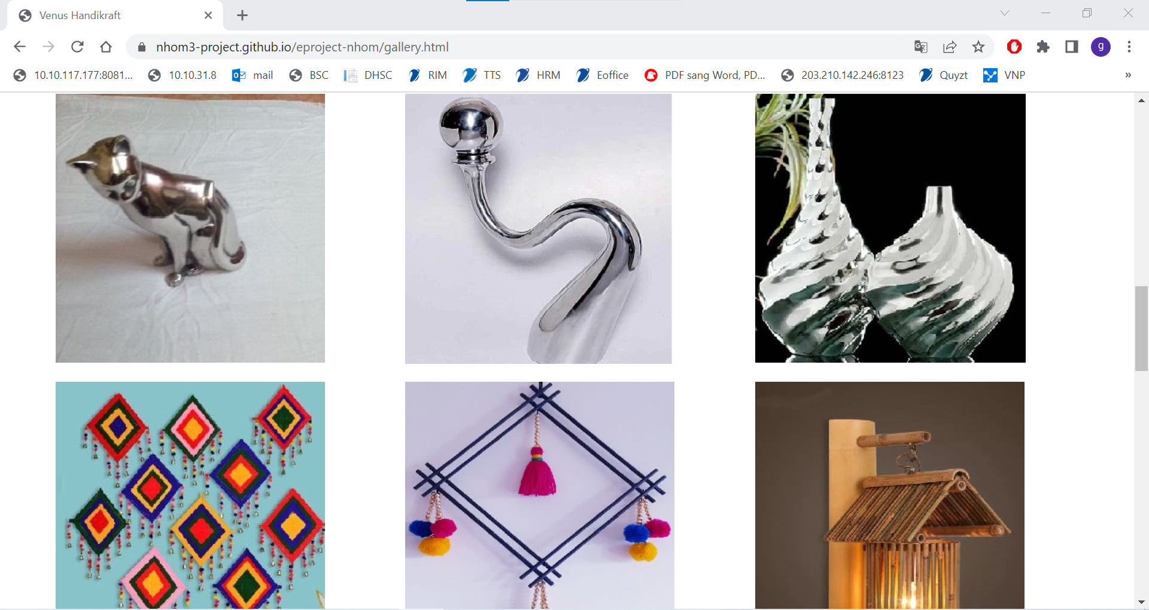
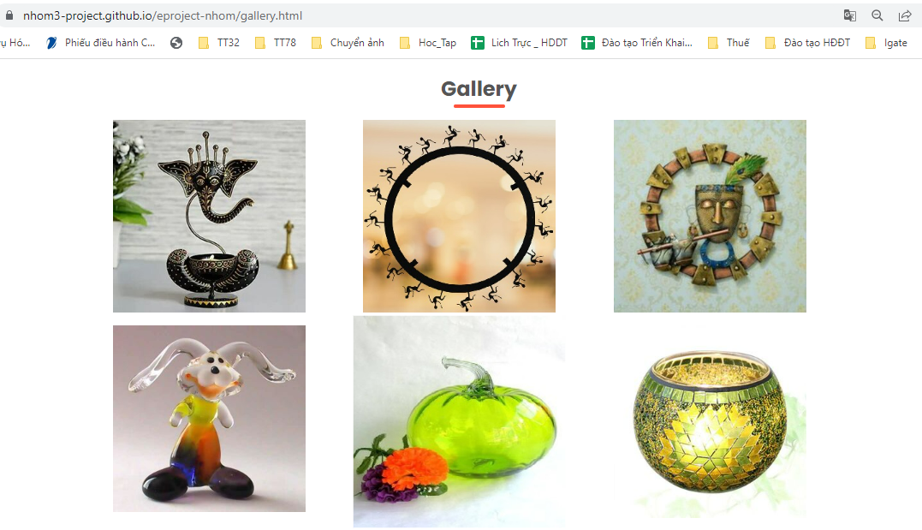
GALLERY

Slide 23
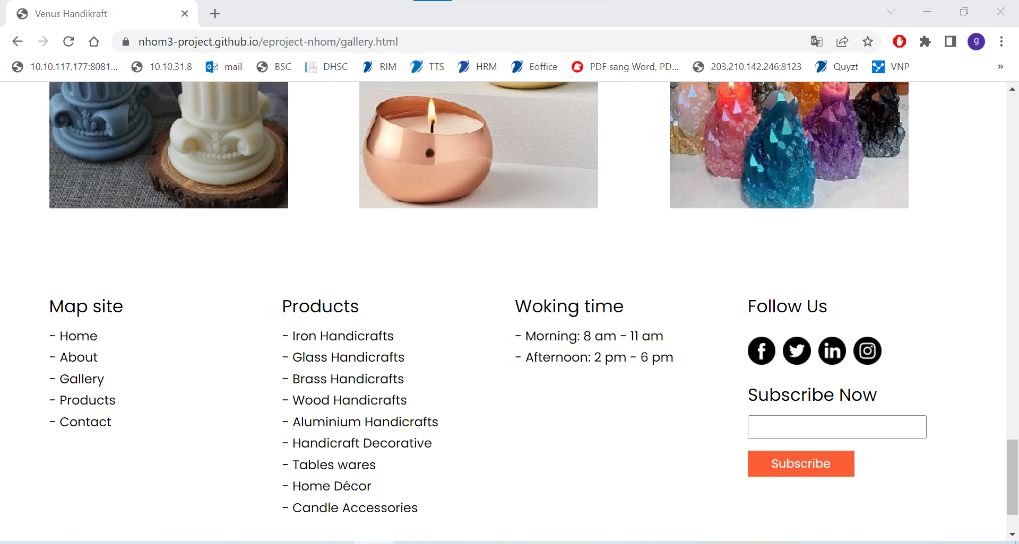
GALLERY

Slide 24
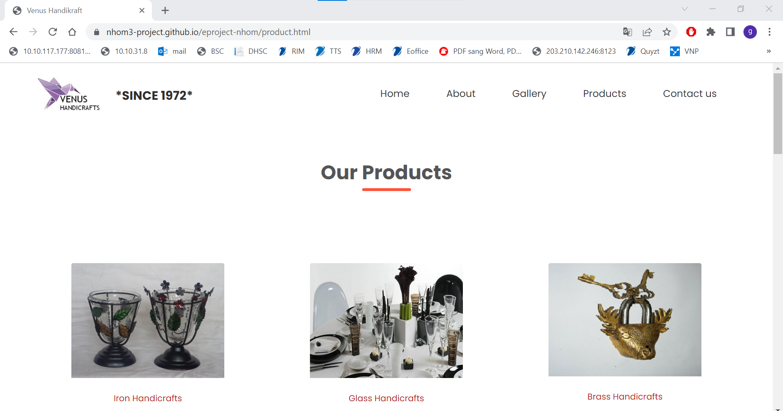
PRODUCTS

Slide 25
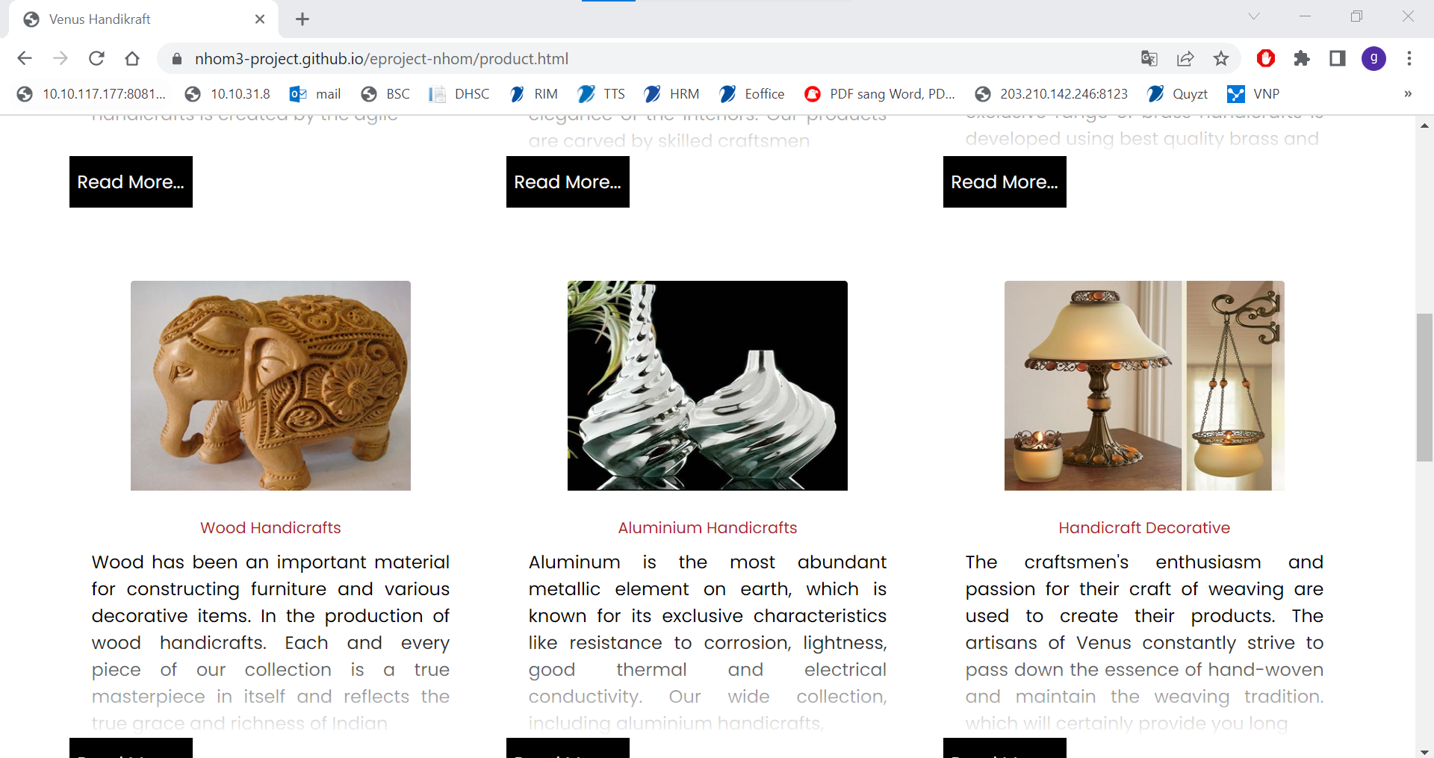
PRODUCTS

Slide 26
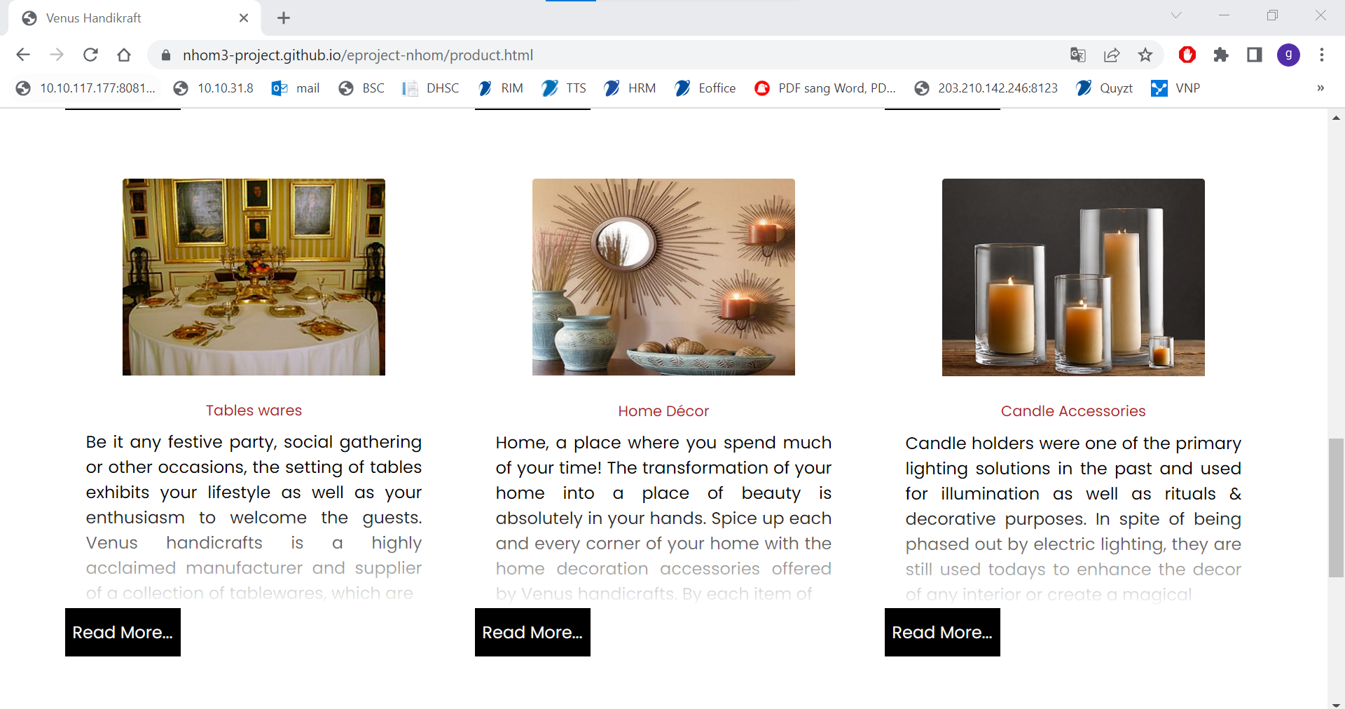
PRODUCTS

Slide 27
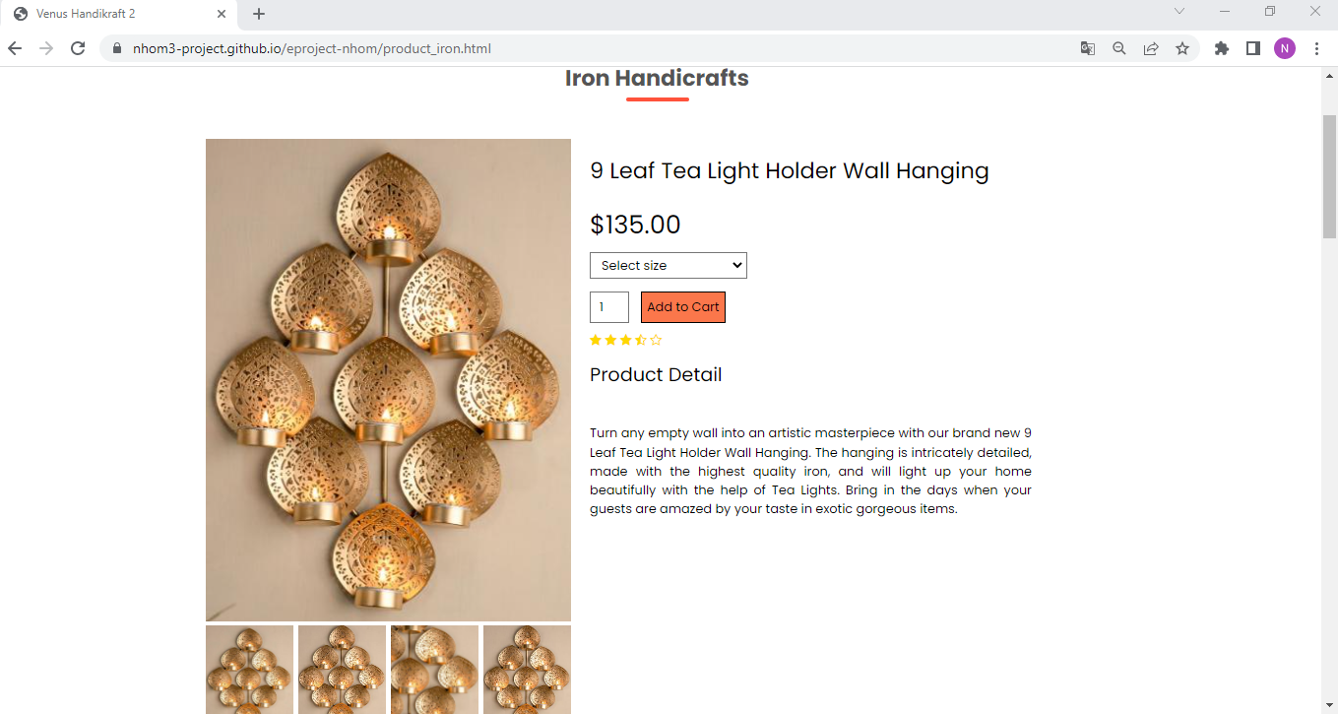
PRODUCT DETAIL

Slide 28
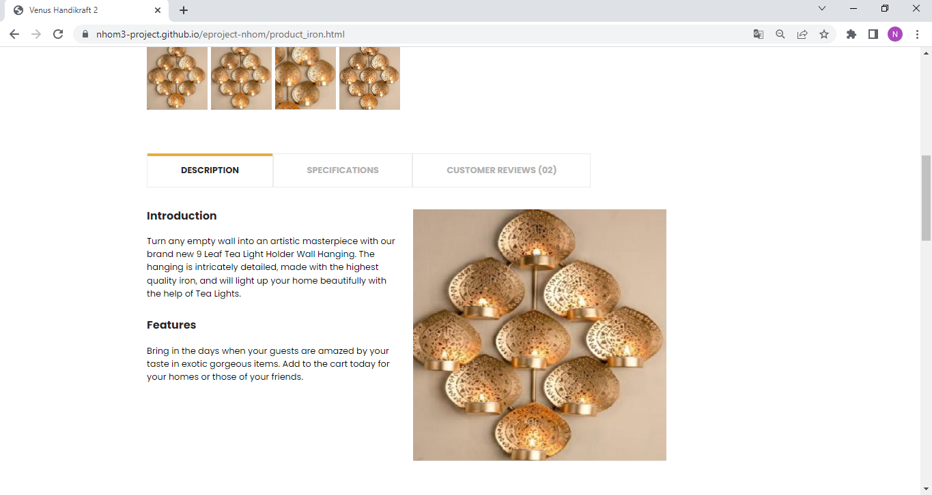
PRODUCT DETAIL

Slide 29
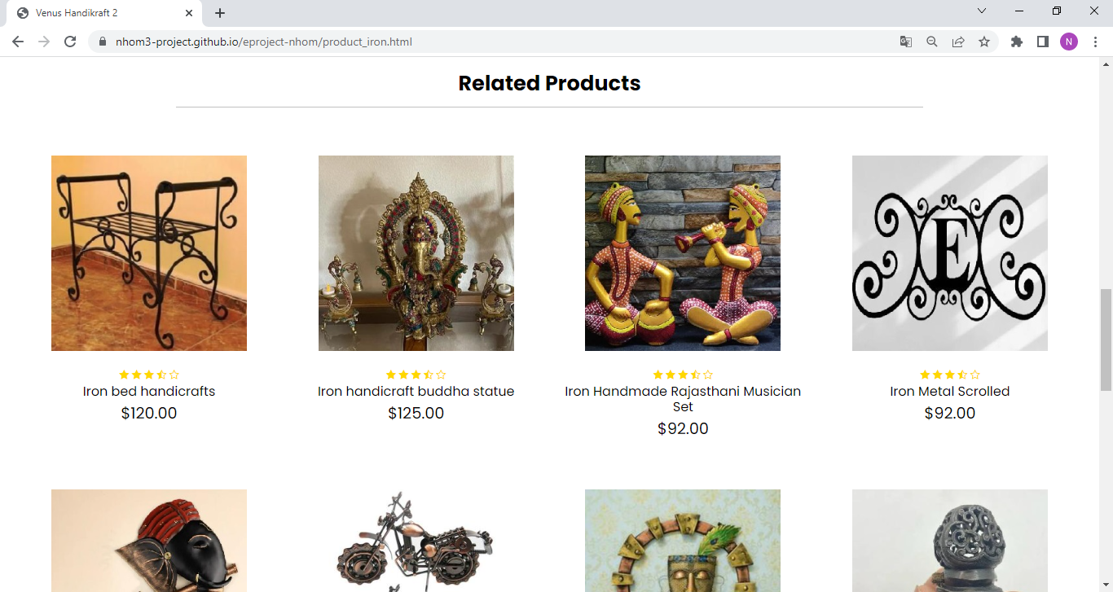
PRODUCT DETAIL

Slide 30
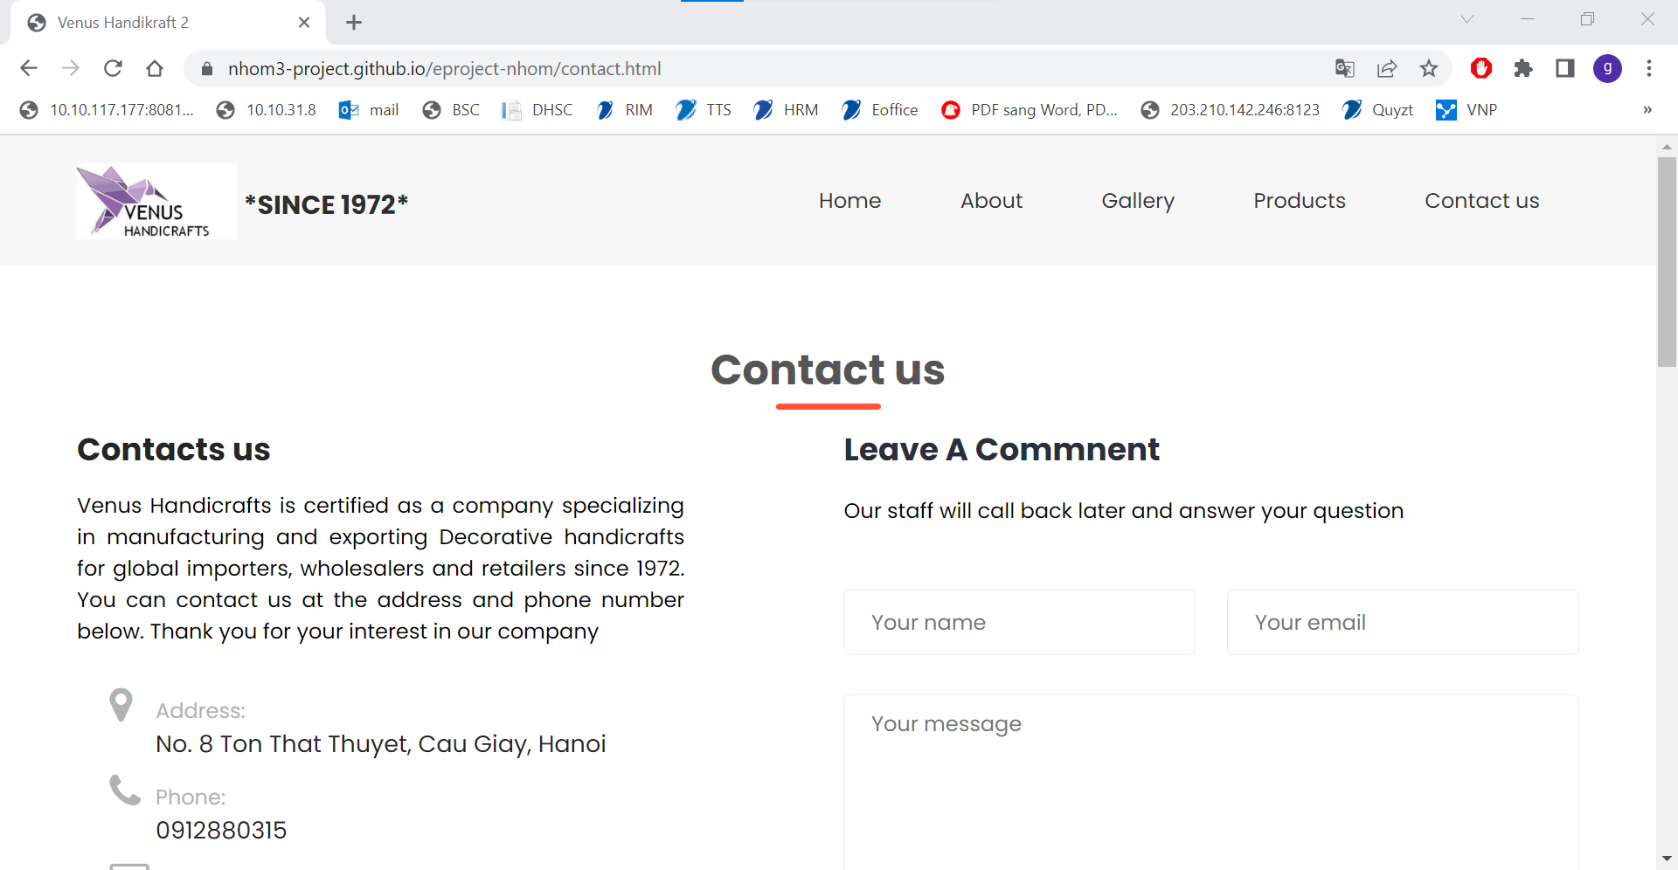
CONTACT US

Slide 31
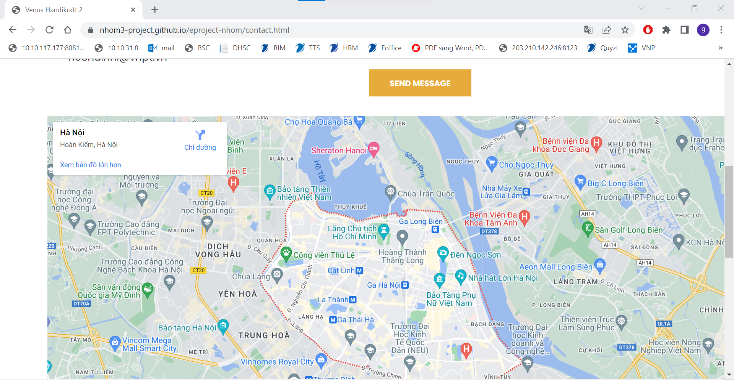
CONTACT US

Slide 32
Summary
Nguyen Duc Quyen
Frame work, Scripts, Testing, Team Coordinator
Kieu Duy Giap
Data, Report.
Nguyen Van Thuy
contact us, Scripts, Testing
Nhu Dinh Hoc
Tran Thu Hang
Product Detail, Cart, Checkout, Scripts, Data, Team Coordinator
Homepage, Data, about us, Team Coordinator.
This website is done thanks to our teacher (Mrs. Đặng Kim Thy), our hard-working and responsible team members

Slide 33
Thank you
Address: No. 8 Ton That Thuyet, Cau Giay, Hanoi
PHONE: 0912880315
EMAIL: hocnd.hni@vnpt.vn

